Slide 1

AI-Driven Public Safety Monitoring Through Pose Estimation and Activity Recognition
ITA0506 – COMPUTER VISION
Presentation By :
Monisha K(192421098 )
Monika P(192425059)
Harshitha G S(192421221)
T Chaitra(192425217)
K Meghana(192321126)
K Teja Sri(192525249)
Program Director : Dr. Sasi Rekha, Prof/CSE
Faculty:- Mrs. R C Jeni Gracia, AP / CSE

Slide 2


AGENDA
Introduction
Literature Review
Problem Statement
Objectives
System Architecture - Overall Design of Project
Modules
Results and discussion
Implementation
Application
Future Scope
Conclusion
References

Slide 3
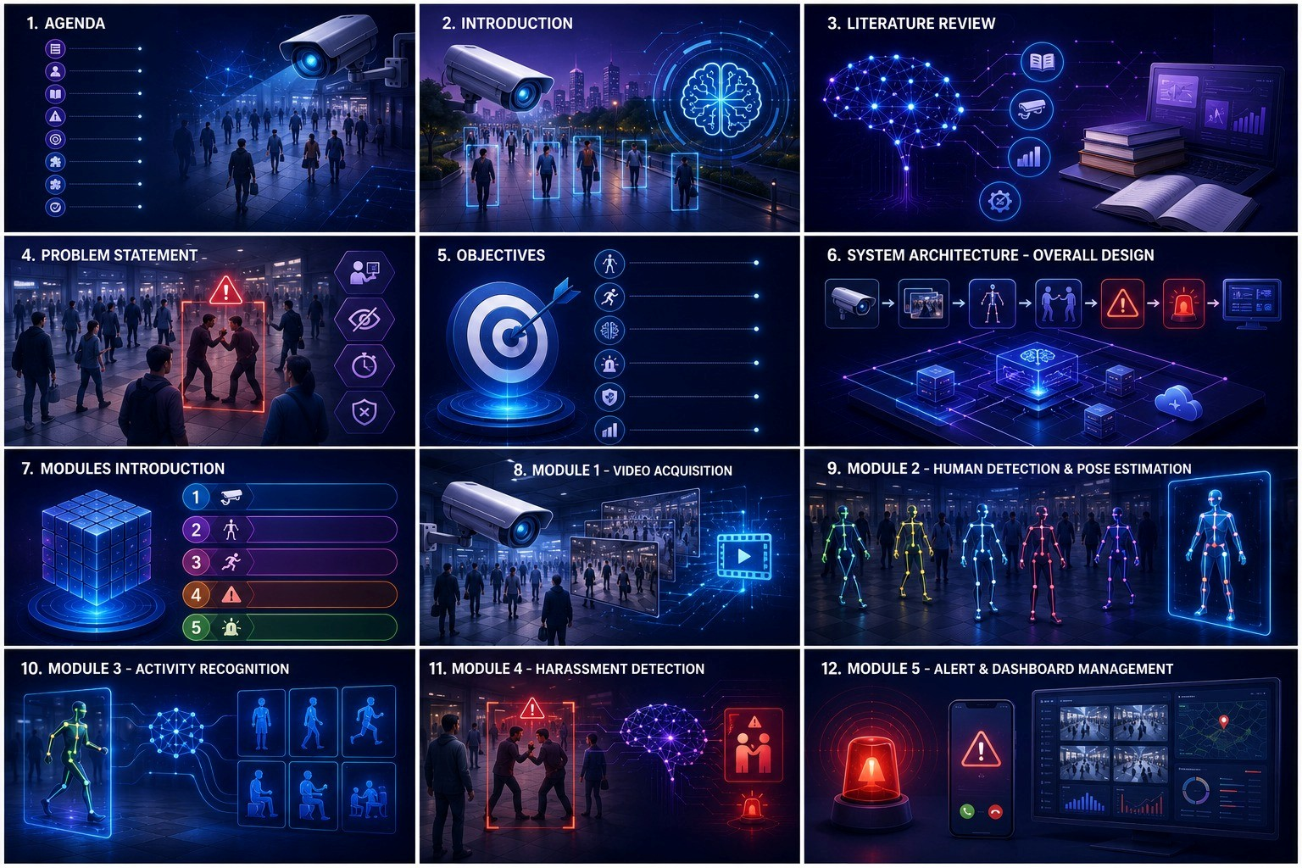
INTRODUCTION
Public safety monitoring is important for detecting dangerous and abnormal activities in crowded public environments.
Traditional CCTV systems mainly depend on manual monitoring, which can be time-consuming and prone to human error.
Computer Vision can automatically analyze video footage to understand human movements and activities.
Pose Estimation identifies important human body keypoints, including the head, shoulders, elbows, wrists, hips, and knees.
Activity Recognition analyzes body movements to identify activities such as walking, falling, fighting, pushing, and suspicious behavior.
The proposed system uses AI-based video analysis to detect potentially unsafe activities and generate alerts for faster response.

Slide 4
LITERATURE REVIEW
S. No | Paper Title | Method Used | Key Finding | Limitation
1 | A. Authors et al. An Intelligent Crime Surveillance Video System for Real-Time Applications(2025) | YOLO, OpenPose, DeepSORT, LSTM | Detects violent activities in real time and generates alerts. | Focuses on violence rather than harassment detection.
2 | Dina Famouri, Md Zarif Hossain, Ahmed ImteajP ose to Protect: Federated Skeleton-Based Anomaly Detection for Privacy-Conscious Video Surveillance(2025) | Pose Estimation Federated Learning | Improves privacy preserving anomaly detection in surveillance videos. | Detects anomalies, not specific harassment events.
3 | Lijuan Zhou, Xiang Meng, Human Pose-Based Estimation, Tracking and Action Recognition with Deep Learning: A Survey(2023) | Deep Learning, Pose Estimation, Action Recognition | Reviews state of the art techniques for pose estimation and activity recognition. | Survey paper; does not propose a detection system.
4 | Thilakarathne, Aiden Nibali, Pose is All You Need: Pose Only Group Activity Recognition System (POGARS)(2022) | Skeleton-Based Pose Recognition, CNN | Accurately recognizes group activities using only human poses. | Limited to activity recognition; not designed for harassment detection.

Slide 5
PROBLEM STATEMENT
Traditional CCTV surveillance depends heavily on continuous manual monitoring by security personnel.
Monitoring multiple cameras simultaneously can result in fatigue, human error, and delayed detection.
Large volumes of video footage make it difficult to identify suspicious activities quickly and accurately.
Existing surveillance systems may detect people but often have limited ability to understand their activities and interactions.
Therefore, an automated AI-based system is required to detect abnormal activities and support faster safety responses.

Slide 6
OBJECTIVES
To develop a Computer Vision system for automated public safety monitoring using video input.
To detect individuals and estimate their body posture and keypoints using pose estimation.
To recognize different activities by analyzing human movement and posture patterns.
To classify activities as normal, suspicious, or potentially dangerous based on predefined patterns.
To generate timely alerts for detected suspicious activities, assisting security personnel in taking appropriate action.

Slide 7
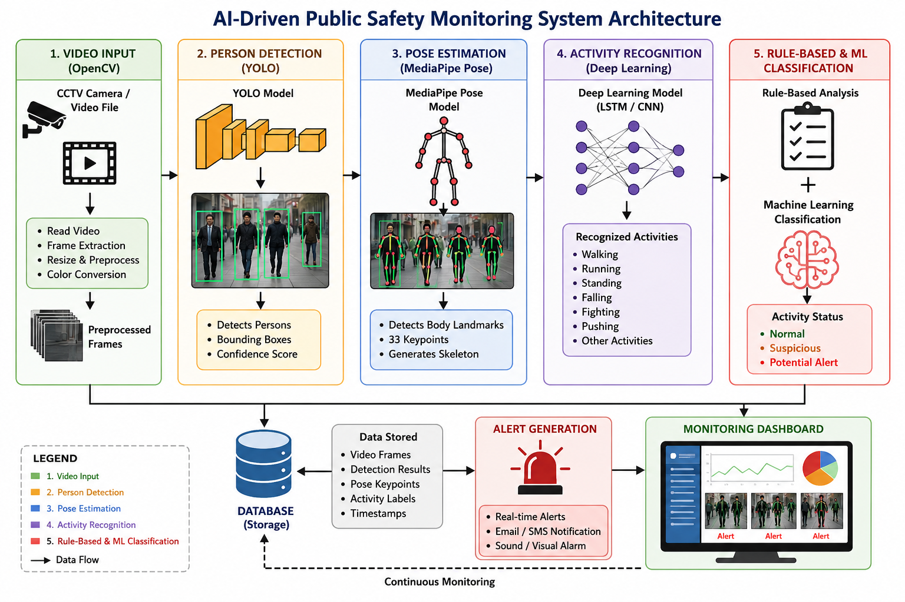
ARCHITECTURE

Slide 8
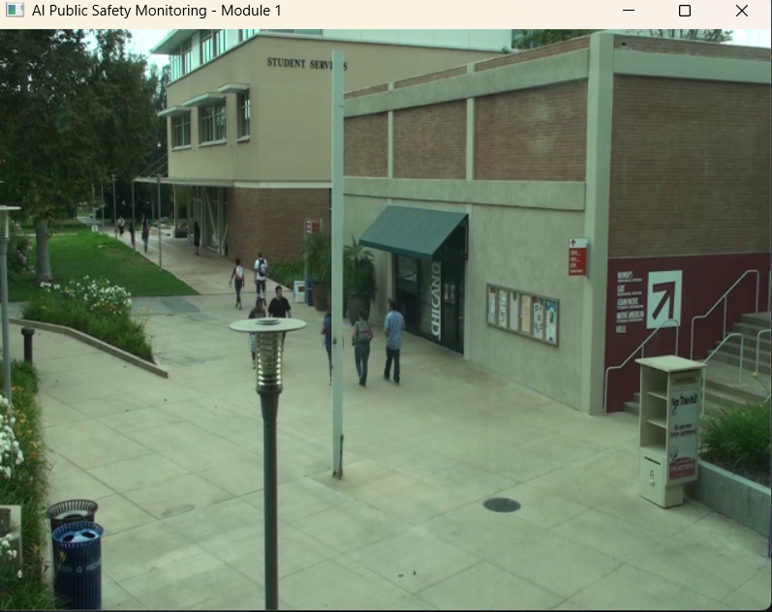
MODULE 1: VIDEO INPUT AND PREPROCESSING
.
What it does: Collects recorded video footage and prepares the video frames for further analysis by the public safety monitoring system.
Technique Used: OpenCV is used for video capture, frame extraction, resizing, and basic image preprocessing.
How it is implemented: The input video is loaded and divided into individual frames. Each frame is resized and preprocessed before being passed to the Person Detection Module for further analysis.

Slide 9
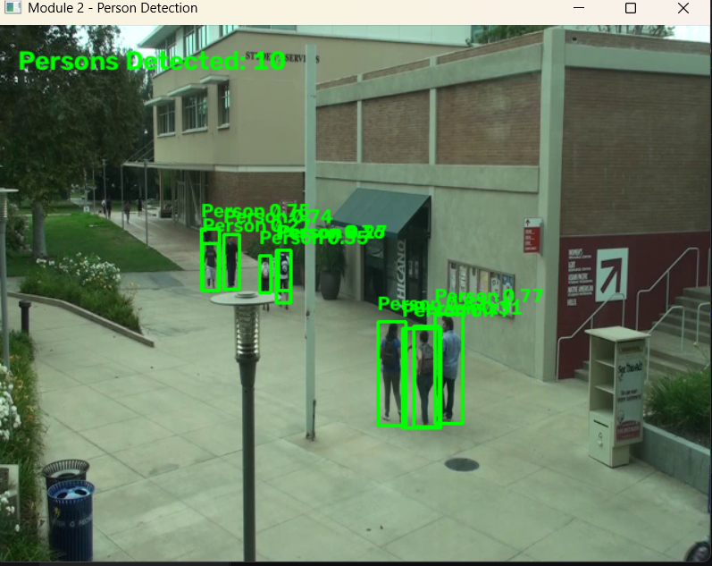
MODULE 2: PERSON DETECTION
What it does: Detects and identifies people present in each video frame so that their movements and activities can be analyzed individually.
Technique Used: YOLO (You Only Look Once) Object Detection is used for detecting people and generating bounding boxes.
How it is implemented: Each preprocessed video frame is given to the YOLO model, which detects persons, draws bounding boxes around them, and provides a confidence score for each detection. The detected persons are then passed to the Pose Estimation Module.

Slide 10
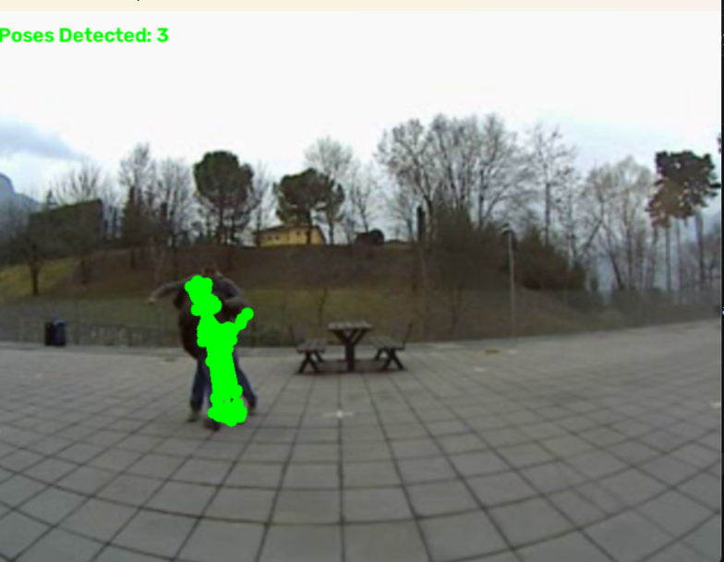
MODULE 3: HUMAN POSE ESTIMATION
What it does: Identifies the body posture and position of each detected person by tracking important body parts.
Technique Used: MediaPipe Pose Estimation is used to detect human body landmarks and generate the skeletal structure.
How it is implemented: The detected person from Module 2 is given to the MediaPipe Pose model, which identifies keypoints such as the head, shoulders, elbows, wrists, hips, knees, and ankles. These keypoints are then used for activity recognition.

Slide 11
MODULE 4 – ACTIVITY RECOGNITION
What it does: Identifies the activity or action performed by a person by analyzing their body posture and movement patterns.
Technique Used: Deep Learning-based Neural Network (CNN) for Activity Classification using extracted human pose keypoints and temporal movement patterns.
How it is implemented: The body keypoints obtained from the Pose Estimation Module are analyzed across consecutive video frames to identify movement patterns. The system classifies activities such as walking, standing, falling, fighting, pushing, and running.

Slide 12
MODULE 5: SUSPICIOUS ACTIVITY DETECTION
What it does: Determines whether the recognized activity is normal, suspicious, or potentially dangerous based on the person’s movement and activity pattern.
Technique Used: Rule-Based Analysis and Machine Learning Classification are used to evaluate the detected activities and identify suspicious behavior.
How it is implemented: The recognized activity and pose information are compared with predefined safety conditions. Activities such as fighting, pushing, falling, or unusual movements are identified as suspicious and marked for further action.

Slide 13

MODULE 6: ALERT AND SAFETY MONITORING
What it does: Provides real-time safety monitoring and generates an alert when suspicious or potentially dangerous activity is detected.
Technique Used: Real-Time Event Detection and Automated Alert Generation are used to notify security personnel about detected threats.
How it is implemented: When suspicious activity is identified, the system displays the activity type, detection status, and alert message on the monitoring interface, allowing security personnel to respond quickly.

Slide 14
RESULTS AND DISCUSSION
The proposed system successfully processes CCTV or recorded video and detects people present in the monitored environment.
YOLO-based person detection identifies individuals, while MediaPipe Pose extracts important body keypoints for movement analysis.
The activity recognition module identifies activities such as walking, standing, falling, fighting, and pushing based on body movements.
The system differentiates between normal and potentially dangerous activities, helping reduce the dependency on continuous manual monitoring.
The combination of person detection, pose estimation, and activity recognition provides an effective approach for automated public safety monitoring and timely alerts.

Slide 15
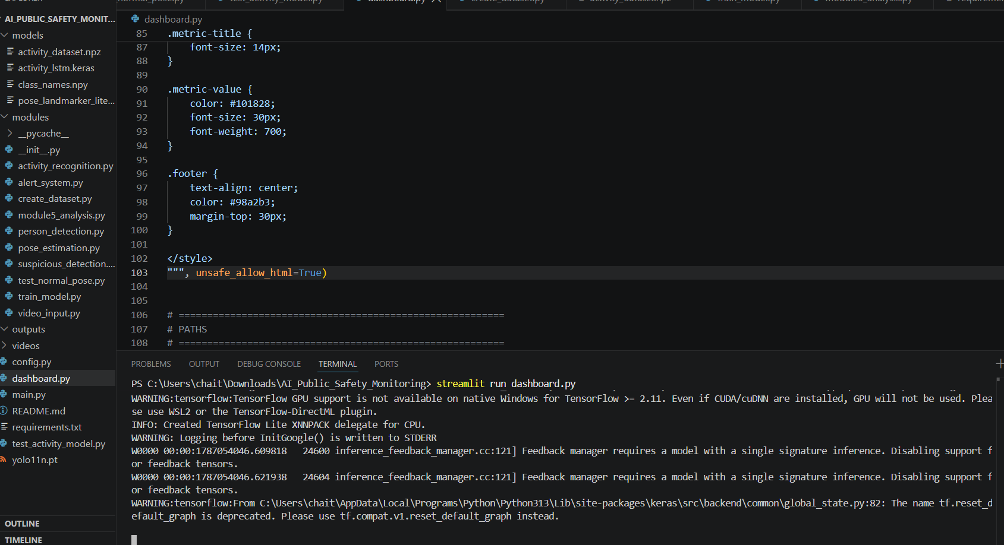
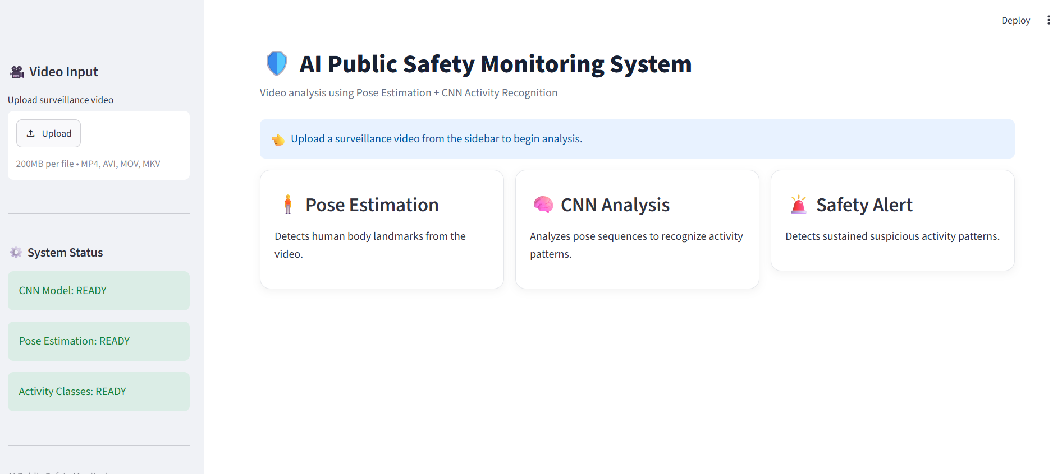
IMPLEMENTATION

Slide 16
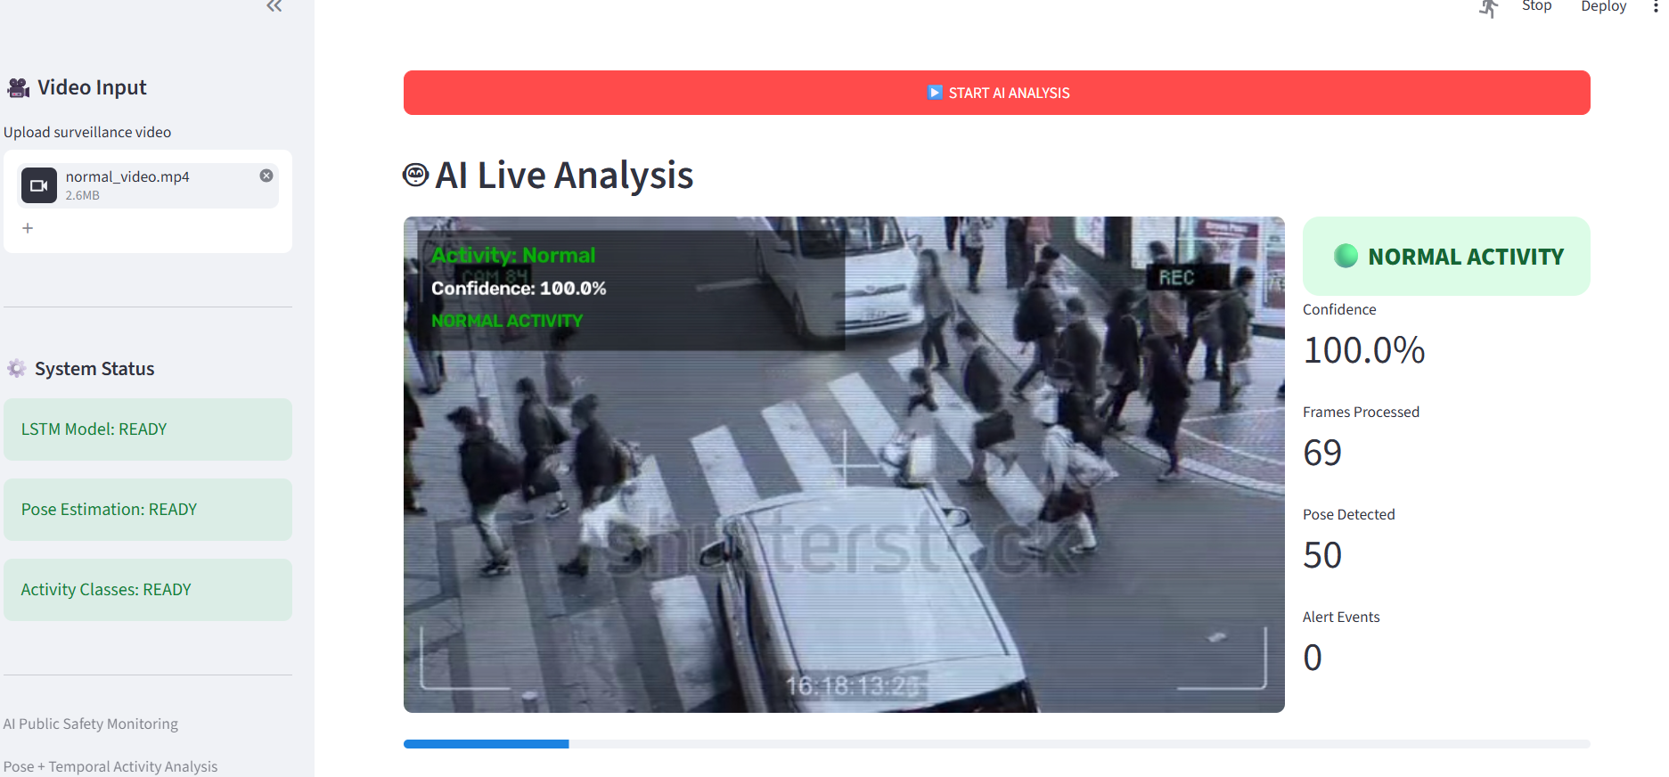
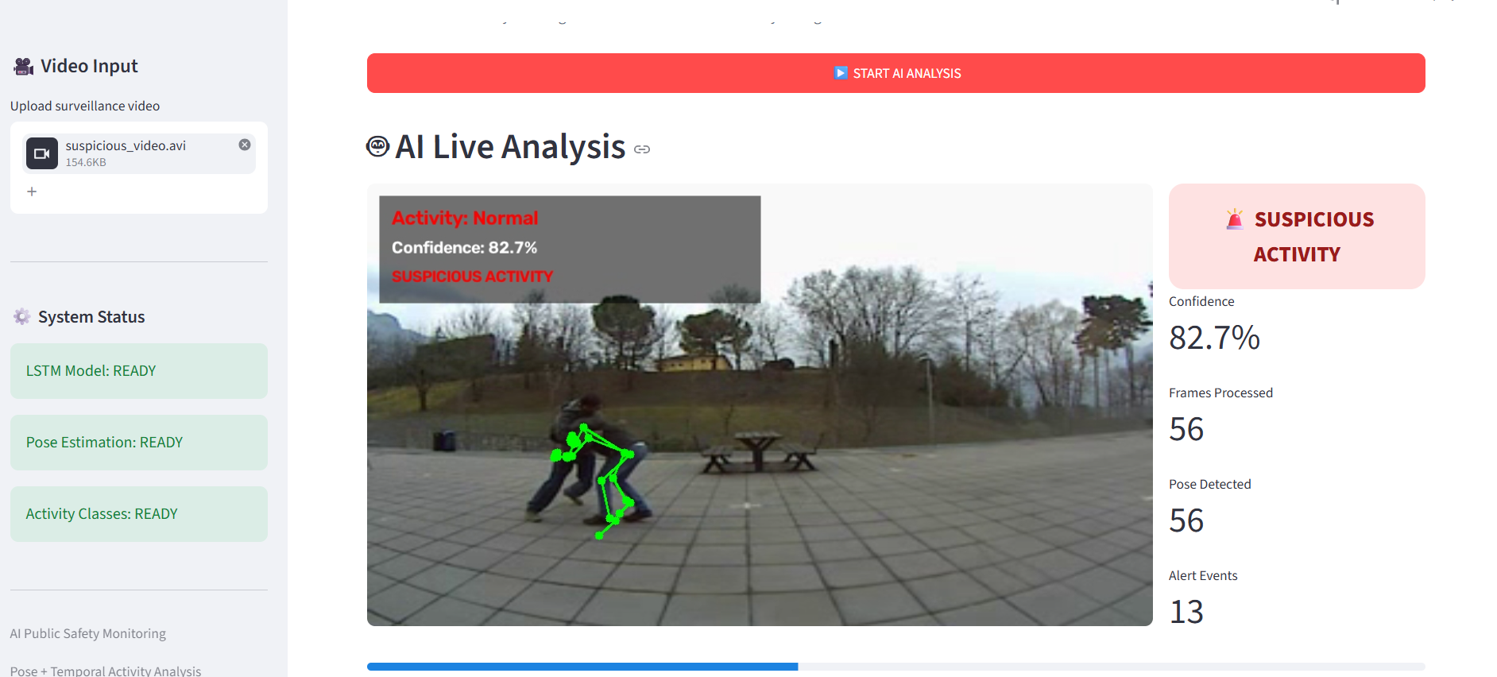
IMPLEMENTATION

Slide 17
APPLICATIONS
Public Places: Can be used in malls, railway stations, bus terminals, airports, and other crowded areas to identify suspicious activities.
Security Surveillance: Helps security personnel monitor CCTV footage and detect fighting, pushing, falling, or unusual movements.
Educational Institutions: Can assist in monitoring schools and colleges for potentially unsafe activities and emergency situations.
Smart Cities: Can be integrated with smart surveillance systems to support automated public safety monitoring across multiple locations.
Emergency Response: Can provide early alerts for dangerous activities, helping security teams respond quickly to potential safety threats.

Slide 18
FUTURE SCOPE
Real-Time Surveillance: Implement the system for real-time monitoring using live CCTV cameras in public places.
Advanced Activity Recognition: Extend the system to recognize more activities such as theft, accidents, running, crowding, and physical violence.
Improved Deep Learning Models: Use advanced models such as LSTM, GRU, Transformers, and 3D CNNs to improve activity classification accuracy.
Multi-Person Tracking: Integrate advanced tracking techniques to continuously monitor multiple people and analyze their movements.
Automatic Alert System: Generate instant alerts through notifications, alarms, or mobile applications when suspicious activities are detected.
Smart City Integration: Integrate the system with smart-city surveillance networks and emergency services for faster response and improved public safety.

Slide 19
CONCLUSION
The proposed AI-Driven Public Safety Monitoring System provides an automated approach for analyzing CCTV and recorded video footage.
The combination of YOLO-based person detection and MediaPipe Pose Estimation enables effective identification and tracking of human movements.
Activity Recognition helps identify normal and potentially dangerous activities such as falling, fighting, pushing, and unusual movements.
The system can generate timely alerts for suspicious activities, reducing the dependency on continuous manual CCTV monitoring.
Overall, the project demonstrates the potential of Computer Vision and AI to improve public safety, surveillance efficiency, and faster emergency response.

Slide 20
REFERENCES
Redmon, J., et al. (2016). “You Only Look Once: Unified, Real-Time Object Detection.” Proceedings of the IEEE Conference on Computer Vision and Pattern Recognition (CVPR).
Lugaresi, C., et al. (2019). “MediaPipe: A Framework for Building Perception Pipelines.”
arXiv preprint arXiv:1906.08172.
Cao, Z., et al. (2017). “Realtime Multi-Person 2D Pose Estimation Using Part Affinity Fields.” Proceedings of the IEEE Conference on Computer Vision and Pattern Recognition (CVPR).
Carreira, J., & Zisserman, A. (2017). “Quo Vadis, Action Recognition? A New Model and the Kinetics Dataset.” Proceedings of the IEEE Conference on Computer Vision and Pattern Recognition (CVPR).
Simonyan, K., & Zisserman, A. (2014). “Two-Stream Convolutional Networks for Action Recognition in Videos.” Advances in Neural Information Processing Systems (NeurIPS).

Slide 21
THANK YOU

